Slide 1
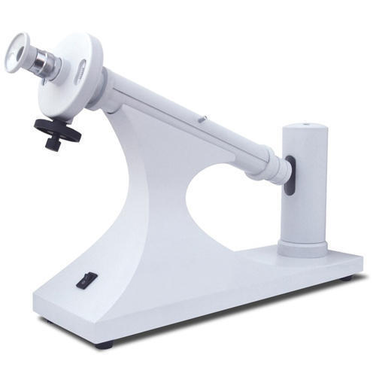
SODIUM LAMP POLARIMETER

Slide 2
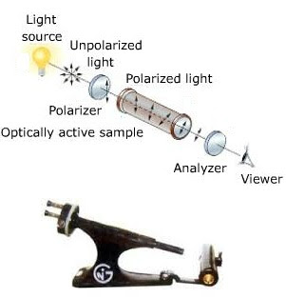
PARTS OF POLARIMETER

Slide 3
